Slide 1
German-Russian Relations as a Factor of EU‘s Eastern Policy: Goals, Consequences and Shifts of Paradigm
Prof. Dr. Peter W. Schulze
Institut für Politische Wissenschaft
Georg August Universität Göttingen
Paper for Moskau/MEF March 2014

Slide 2
Options in EU-Russian Relations
Integration
Status quo
Modus Vivendi
Revision

Slide 3
Conflict Reduction -Cold War: Change through Rapprochement
Germany‘s New Eastern policy: Strategic objectives: normalisation, improvement of social conditions and freer movement of German citicens from the GDR to West Germany;
Instruments: acceptation of the Status quo , including post second world war borders, deescalation of conflicts and move toward normalisation of relations between Eastern and Western European states
„Change through Rapprochement“ (Egon Bahr, 1963)
This principle was applied from the 1970s until the new Millennium
2005-2009: SPD/CDU black-red coalition: Partnership in Modernisation: „Change through building networks“

Slide 4
Challenges to Germany‘s Eastern Policy
Crisis of the EU and power shift amway from the French-German Tandem toward Berlin‘s role as a „reluctant hegemon“
Quality of US-Leadership is vaning; Washington needs Europe as a „strategic partner“ to shoulder challenges stemming from power shift in the international system
Struggle of the future: who controlls Germany- Russia a mischief-maker intruding the transatlantic relationship

Slide 5
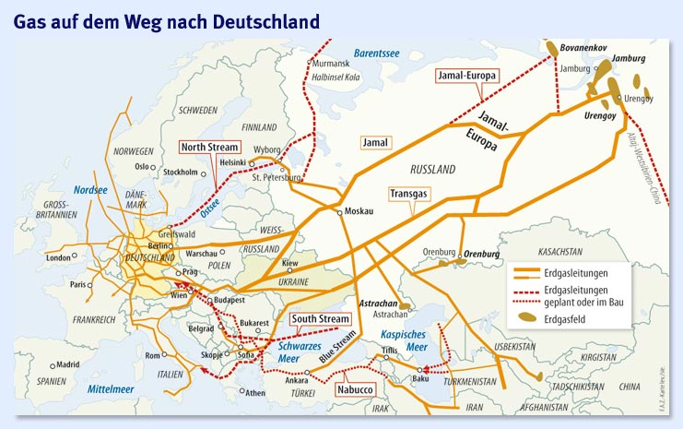
Gaspipelines to EU-Europe

Slide 6
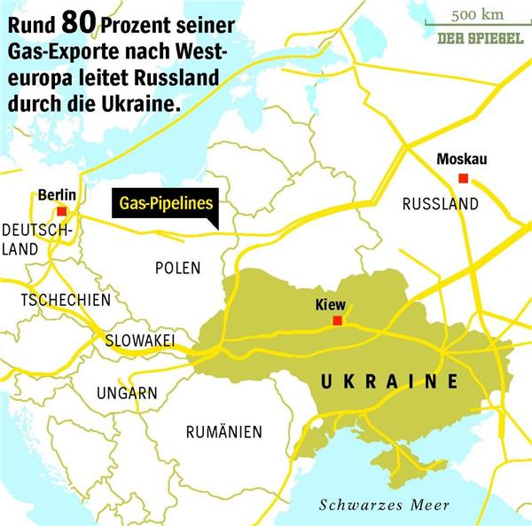
The Dominance of the Ukraine as a Transit Country for Russian Gas

Slide 7
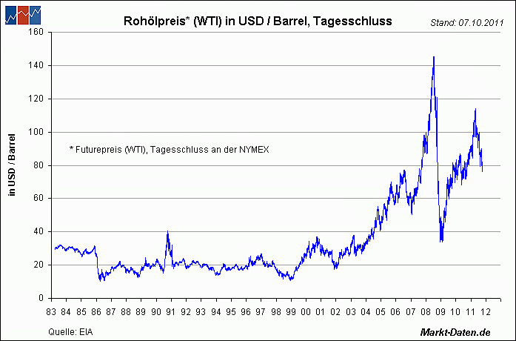
Preisentwicklung Rohöl, Folgen für Perestroika und Transformation
Oil prices, consequences for reforms in the 1980s and 1990s

Slide 8
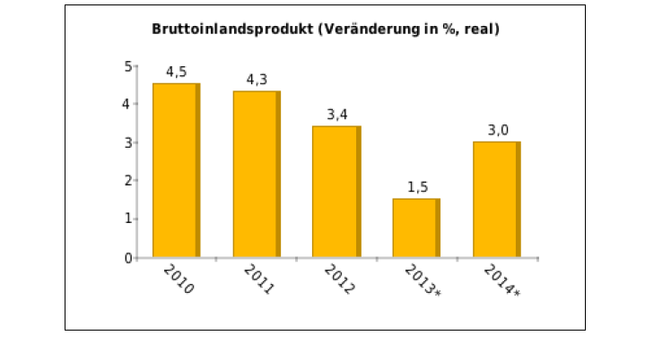
GDP 201- 2014 (est.)

Slide 9
Industrial Production acc. to Sectors
Jan.-to July 2013
Industrial production : overall 0%
Metallurgy -0,9%
Machines/Investment goods -6,5%
Electronic, Optics -5,3%
Chemical goods 3,3%
Rubber, Plastics 7,8%

Slide 10

Public debt

Slide 11
Annual New Public Debts

Slide 12
Investments: incoming

Slide 13
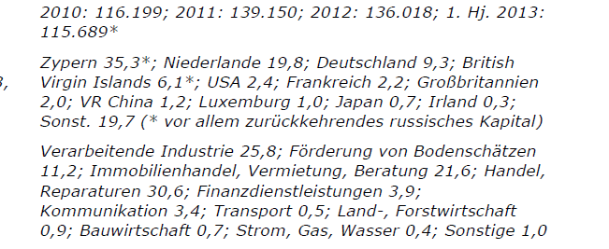
Total Investments 2010-2012
Countries of Origin, Sectors

Slide 14
GDP in International Comparison

Slide 15
Russian GDP in intern Comparison
GDP growth in 2012 of 3,4% will be reduced in 2013 to 1,8%;
Only in 2014 there will be growth decline to –minus 0,7 %, eventually reaching 2,7% in 2017.
In comparison:
China 2012 , growth of 7,8%
Indian growth of 5,4%
Russia on the lower rang in BRICS-grouping

Slide 16
Trade : Germany‘s Exports to Russia by economic sectors

Slide 17
Russia‘s Exports to global markets

Slide 18
Imports to Russia

Slide 19
German direct Investments in Russia

Slide 20
Russian Trade: Imports according to world regions

Slide 21
Exports according to world regions

Slide 22
Trade EU -27 with Russia: Export/Import of Goods /EU/Russia

Slide 23
Russian Imports according to products

Slide 24
Russian Exports according to world products

Slide 25
Foreign Trade Proportion of Customs Union with Member States
2008 – 2011, % of trade)

Slide 26
Russia’s trade with CIS 1994 – 2010
Bill. USD and % of Export and Import

Slide 27
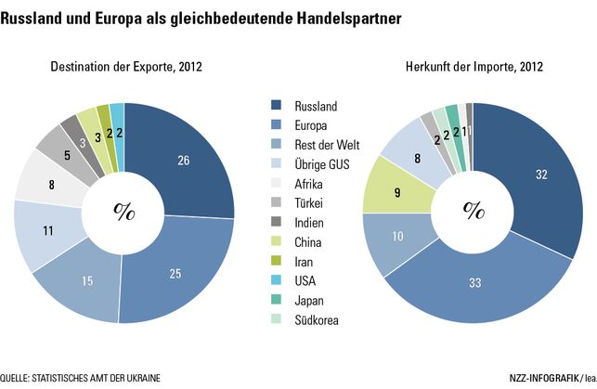
EU and Russia: Trade with the Ukraine
2012

