Slide 1


Future Leadership Competency Requirements: Global Tendencies and Russian Specifics
Kathleen Zabelina
Business School Director – The Moscow University of Finance and Law
March, 2014

Slide 2
Agenda
Key competencies requirements for business leaders in the next 5 years: Global trends
Review of existing competency profile of Russian leaders, and applicability of global findings in context
The role of Russian culture and history : barriers to leadership development
Why corporations needs to assume accountability of developing human capital in Russia

Slide 3
Background
Leadership Competencies: Why do they matter?
In spite of record unemployment levels across many developed economies, one of the biggest risk that global businesses now face is a talent and skills shortage.*
Based on global research studies conducted on this topic, approximately 50% **of current leaders are ineffective in the skills critical for the next three years, and this issue impacts the productivity and bottom line of their firms.
Demographics- baby boomers are retiring, and there are not enough competent and experienced managers available to take their place.
* Source: 2011 Llyod’s Risk Index
** Source: “Development Dimensions International (DDI) Global Leadership Forecast 2012”

Slide 4
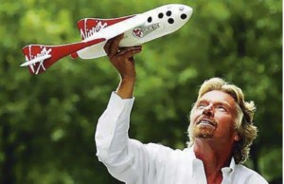
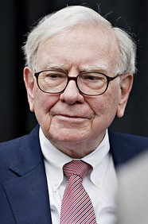
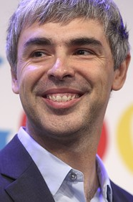
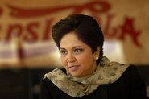
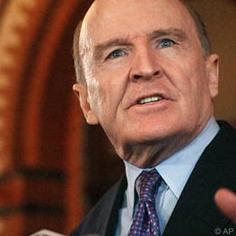
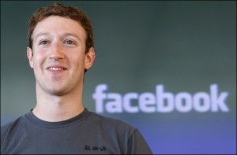
What Makes these Leaders Great?

Slide 5
Top 5 competencies required for the next three years by leaders globally
According to a study published in 2012 by Development Dimensions International (DDI), which aimed to measure the perception of the current quality of leaders globally, a significant gap exists between current skill strengths and future requirements.
Top 5 Requirements
Fostering creativity and innovation
Identifying and developing talent
Driving and managing change
Coaching and developing talent
Executing organizational strategy
Current Strengths
Interpersonal skills
Technical skills
Building customer loyalty
vs.
All 5 competencies defined as key for the next three years, share the common aspect of driving the business forward.

Slide 6
Global Leadership Competency Findings: Applicability to Russia
Separate research published in 2006 by Grachev & Bobina specifically analyzed current leadership behaviors and competency levels amongst Russian leaders, that were identified as part of a large cross cultural research program entitled the “Globe Study”.
The Globe study findings, as analyzed by Grachev and Bobina, help to build a competency profile for Russian business leaders.
(+) Stregths
Technical skills
Decision-making
Executing performance results
Neutral
Building relationships
Networking
Communication skills
Team orientation
(-) Weakness
Innovation
Identifying /developing talent
Creating strategic vision
Risk management
Those competencies that were defined as key in the DDI survey, strongly overlap with skill weaknesses of Russian leaders, identified in the Globe study .

Slide 7
Global Leadership Competency Findings: Applicability to Russia
Due to the significant time period that elapsed between Grachev & Bobina’s findings and the publication of DDI’s research, a need was identified to conduct independent research to identify if additional competencies would be key for Russian leaders in the next three years.
An online survey was created and distributed to business leaders, HR managers, and MBA faculty in Russia. 54 respondents participated.
Key findings include:
30% of respondents agreed that the top 5 competencies identified as critical for leaders by DDI were fully applicable for Russia.
43% found DDI’s results somewhat applicable, and 27% indicated that they were not applicable at all.
When asked to select other critical competencies from DDI’s list, 71% chose “Building networks and relationships” and 51% selected “Communication & Interpersonal Skills””.

Slide 8
Matrix of Key Competencies and Development Needs for Russian Leaders
(Short-term, next 3 years)
Leadership Competencies identified as key in next three years (DDI Global Study) | Additional Competencies identified as key for Russian leaders (Author’s Survey) | Current Competency Level of Russian Leaders, according to Grachev and Bobina (Globe Study)
Change management |  | Low
Identifying and developing future talent |  | Low
Encouraging creativity and innovation |  | Low
Coaching and developing others |  | Low
Execution of organizational strategy |  | High
 | Building networks and relationships | Medium
 | Communication & interpersonal skills | Medium

Slide 9
Russian Investment in Human Capital Development: Historical Perspective
20th Century Practices:
Highly Educated Workforce
99.8% literacy rates
Leading higher education- especially in science and mathematics
Professions with Formal “Continuing Education” Requirements
Update one’s skills approximately every 5 years
Goal: stay up-to-date with latest trends and developments in profession
Learning Style
Emphasis on strong theoretical and technical knowledge
Teaching methodology –mainly lecture-based, rather than interactive in nature.
Strong vocational training
Low emphasis on “soft skills” development

Slide 10
The Role of Russian Business Schools: Leadership Competency Development
When incorporating leadership competency requirements into program curriculums, learning preferences of Generation Y learners into consideration.
Listening & Learning from Experience of Others
Instant & Continuous Feedback
Technology

Slide 11
Cultural Barriers to Leadership Development
People learn to be leaders by doing leadership work.
Practical experience is key.
Bass & Hoftseade’s Cultural Values Theory of Leadership:
7 Factors influence Leaders becoming “Transformational” or “Transactional”
Individualism
Fatalism
Paternalism
Low
High
Long-term Strategy
Competitive Behavior
Risk Avoidance
Power Distance
When this model is applied to Russia, we can see that the cultural behaviors contributes to developing transactional leaders, meaning that many Western-based management styles are difficult to implement in Russia.

Slide 12
The Role of Businesses: Leadership Development
According to a 2012 study published by the Hay Group, who has been running employee effectiveness studies since 2005 in Russia, 66% of respondents believe that their companies are not able to retain their best talents.*
In order for this situation to change, businesses in Russia need to:
Align HR Policies and Practices
Integrate leadership competency requirements into hiring and promotion processes.
Develop Key Performance Indicators (KPIs) to measure performance.
Align Mission Statements, Corporate Culture & Processes
Champion change and innovation as positive drivers for growth.
Senior executives to frequently communicate these values and exhibit these behaviors to employees.
Develop Internal Talent
Delegate decision-making authority.
Provide learning and development opportunities.
Action Learning: 70/20/10
Link pay to performance.
Design internal processes and procedures that encourage desired behaviors.
Make leaders accountable for identifying and developing their successors.
*Vyalova, A., Kiryushkina, E., and Shatova, E. (2012). Russian Companies' Secret Weapon: Taking the Next Step in Boosting Performance. Moscow, Russia: Hay Group.

Slide 13
Conclusion:
The quality of senior leadership teams in will become a more important issue to businesses in Russia in the future.
Additional Drivers for Change:
According to a 2012 study conducted by Deloitte’s Human Capital Consulting practice, 80%of 455 investment analysts surveyed are now using the quality of a company’s senior management team when assessing its value (p.4).
The current demographic situation will prompt companies to develop their internal talent pipeline. A first round of success stories - that is, a core number of internally developed corporate talent rising to assume executive level positions, will reinforce this best practice.
Corporations, in partnership with educational institutions, must assume accountability for improving the quality of the future generation of Russian business leaders .
* Holland,S. & Thom,M. (2012). The Leadership Premium- How Companies Win the Confidence of Investors. London, UK: Deloitte Touche Thomatsu Limited.

